Slide 1

Machine Learning with H2O
Jo-fai (Joe) Chow
Data Scientist
joe@h2o.ai
@matlabulous
Budapest Data Science Meetup
Prezi House of Ideas
2nd September, 2016

Slide 2
About Me: Civil Engineer → Data Scientist
2005 - 2015
Water Engineer
Consultant for Utilities
EngD Research
2015 - Present
Data Scientist
Virgin Media (UK)
Domino Data Lab (US)
H2O.ai (US)
Why? Long story – see bit.ly/joe_h2o_talk1

Slide 3
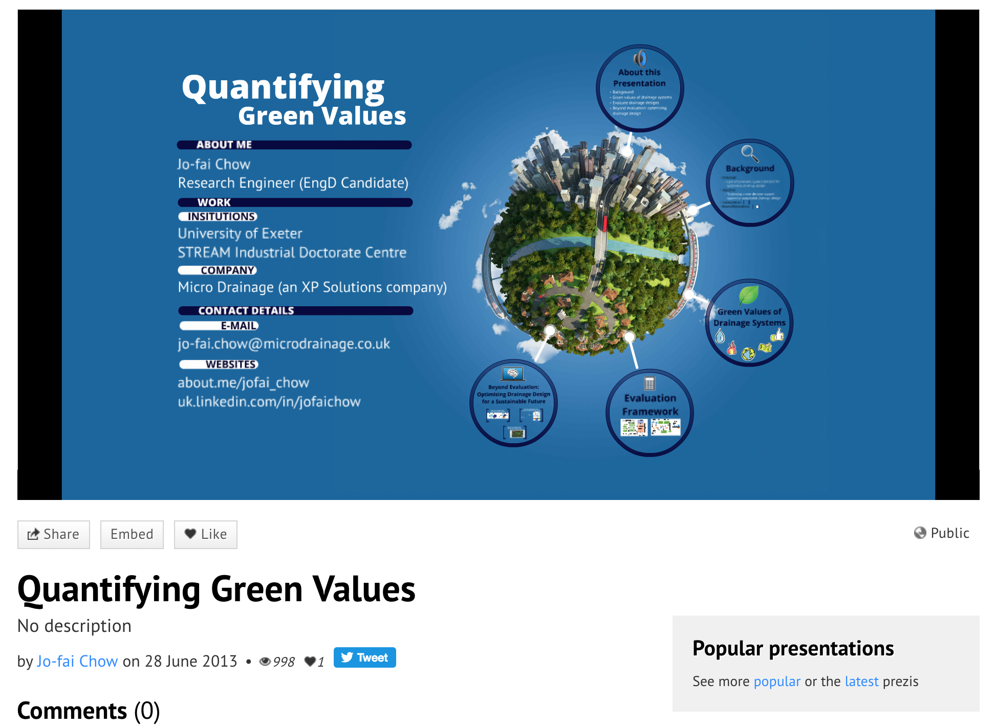
I love Prezi!
My favorite presentation during my EngD time.

Slide 4
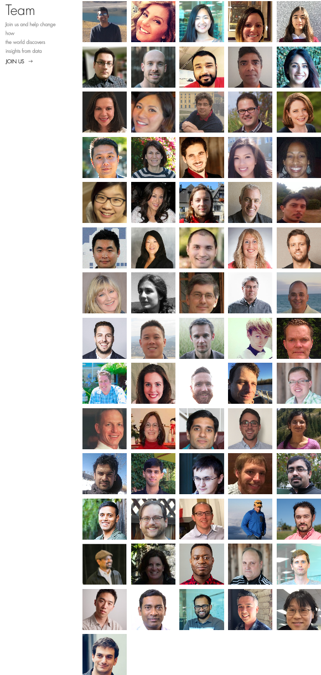
About H2O.ai
H2O.ai, the Company
Team: 80 (71 shown)
Founded in 2012,
HQ: Mountain View, California
H2O, the Platform
Open Source (Apache 2.0)
R, Python, Scala, Java and Web Interfaces
Distributed Algorithms that Scale to Big Data
Works with Laptop, Hadoop & Spark
Jakub
(Kuba)
Joe
Notes:
Team is growing rapidly
Based in Mountain View – I am the only guy in UK/Europe
VC: $34M in total

Slide 5
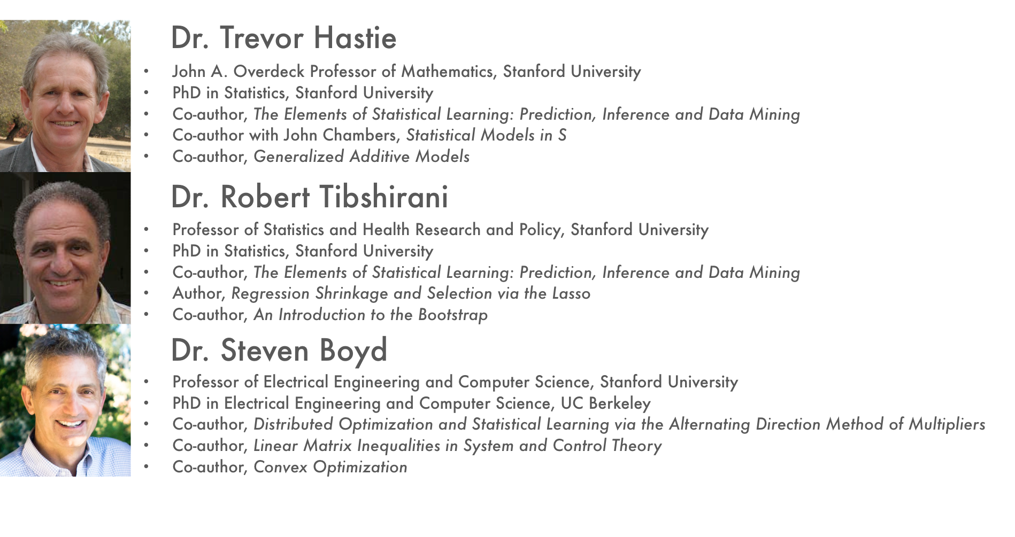

Scientific Advisory Council

Slide 6
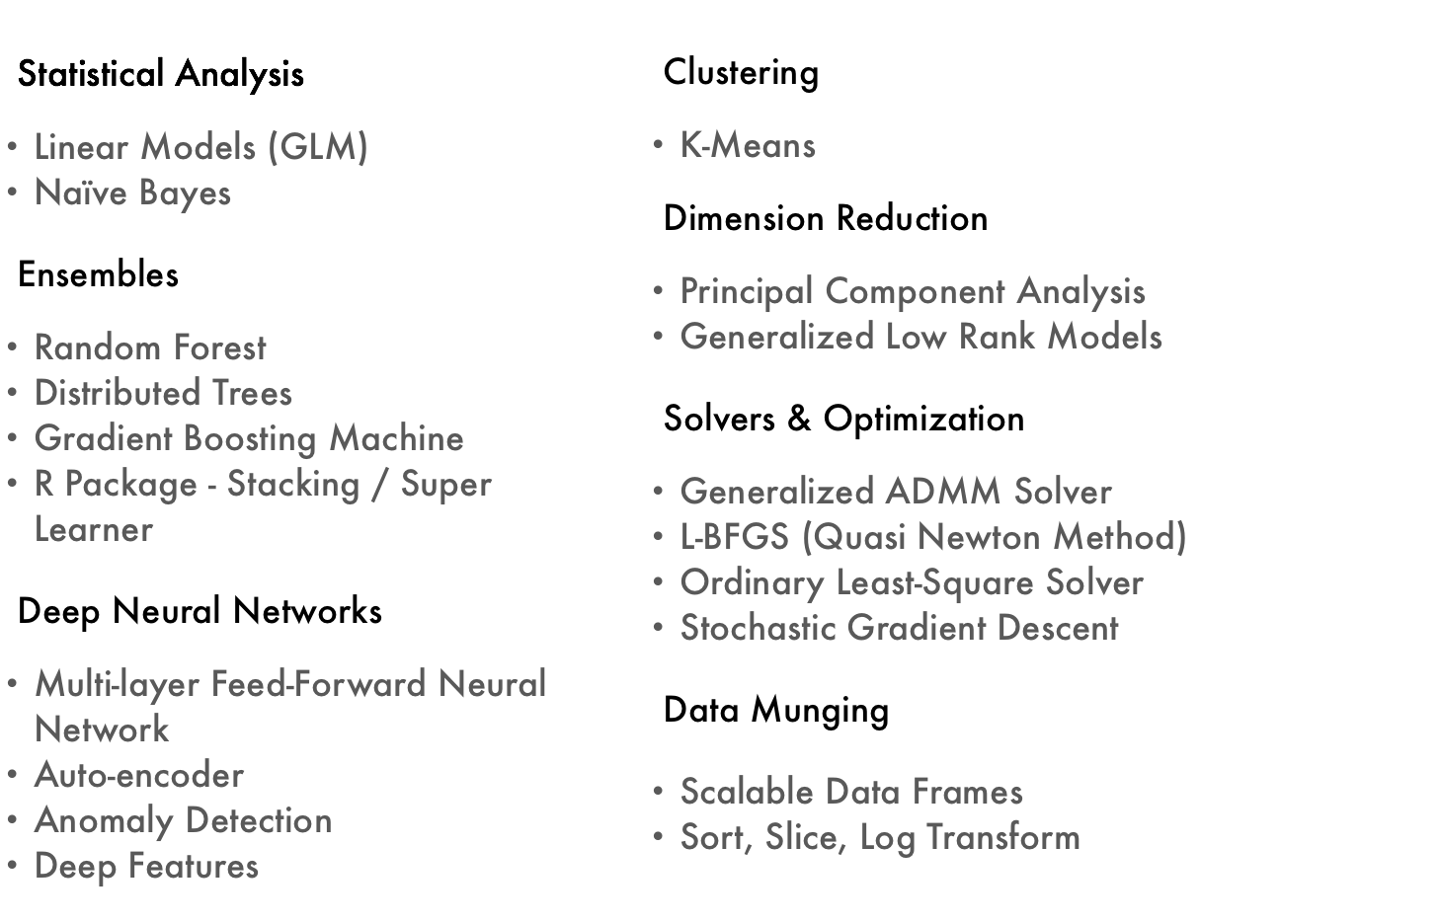
Current Algorithm Overview
See bit.ly/joe_h2o_talk4

Slide 7
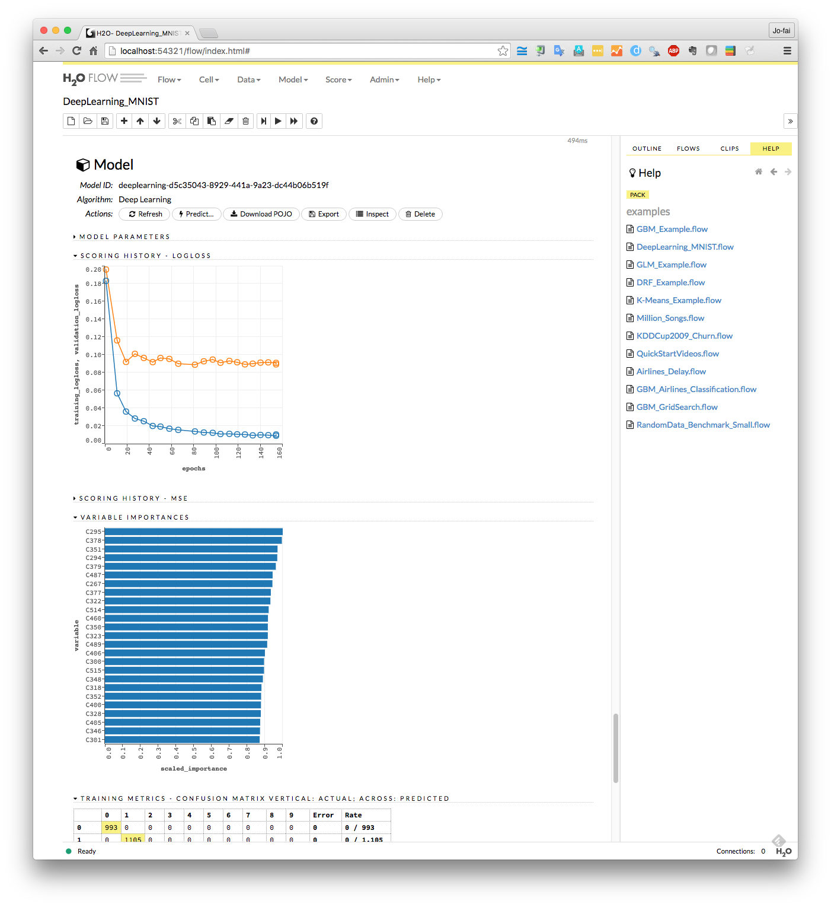
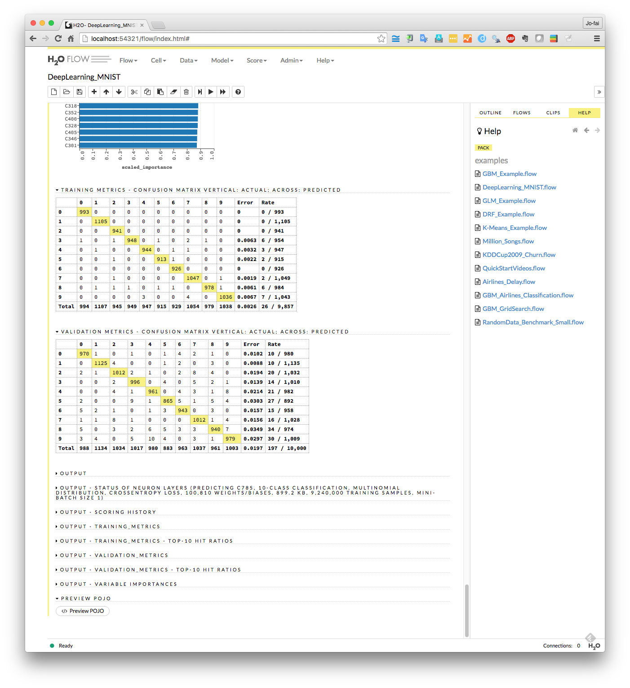
H2O Interfaces – Web (H2O Flow)

Slide 8
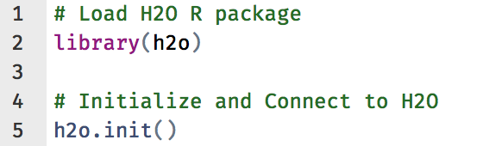
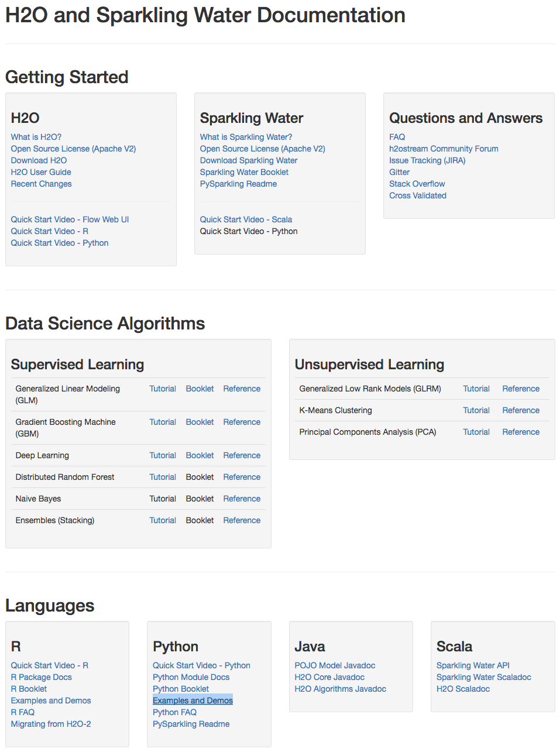
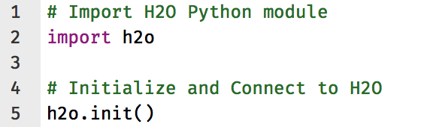
H2O Interfaces – R, Python & Others
R
Python
Resources - docs.h2o.ai

Slide 9
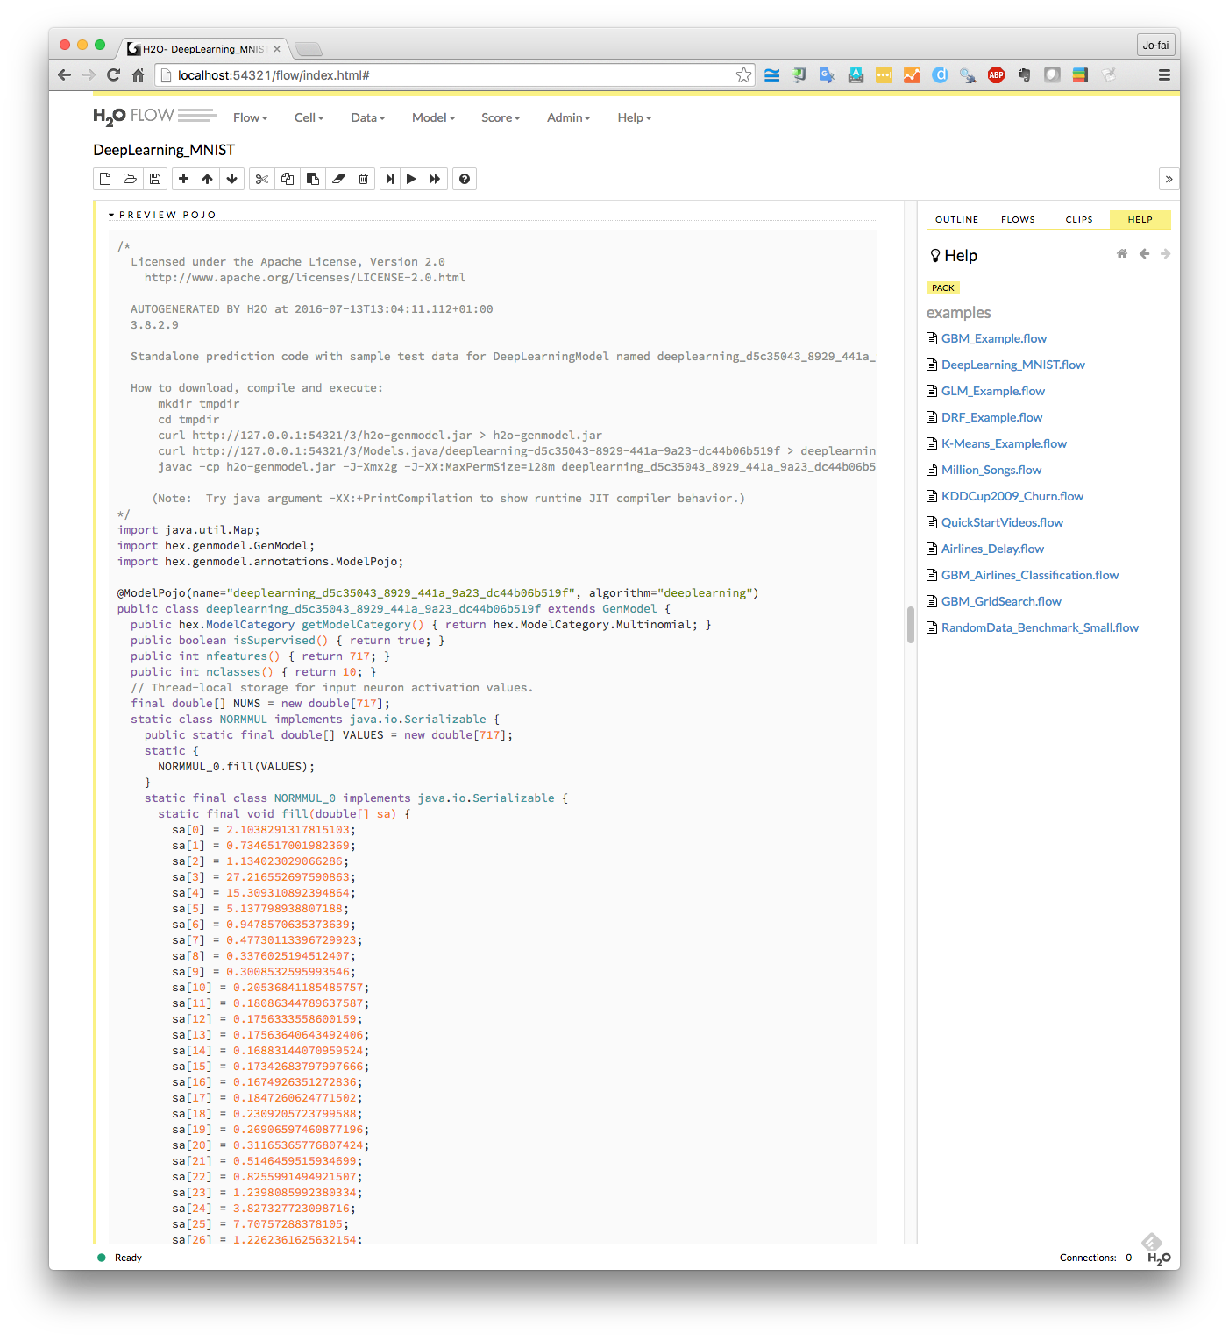
Export Plain Old Java Object (POJO)

Slide 10
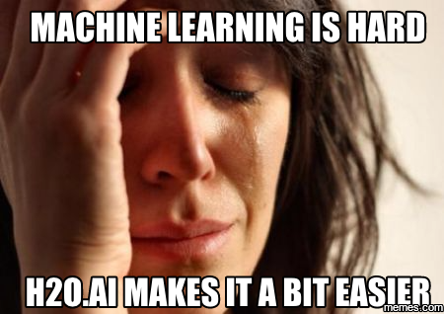
Why H2O?
Previous Budapest DS Meetup
Big thanks to Szilard Pafka
Intro to ML with H2O
Link (video)
Link (Slides)
Szilard’s Summary Slide

Slide 11
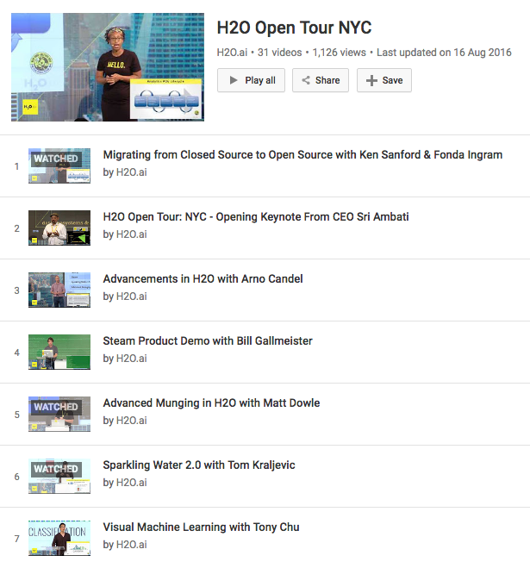
H2O is Evolving
Advanced data munging
Visual ML
Deep Water
H2O + TensorFlow, mxnet, Theano, Caffe …
GPU
Steam
YouTube Playlist

Slide 12
H2O at satRday #1
Hands-on Workshop (0800)
H2O R package
Scalable machine learning
Model training, tuning and stacking
Machine Learning Use Cases (1600)
How others use H2O for their projects

Slide 13
Three More H2O Talks
Zsolt Toth
Rapid Miner + H2O Integration (20 mins)
Norbert Liki
Data Mining with H2O at Telenor (20 mins)
Jakub (Kuba) Háva
Sparkling Water 2.0 (35 mins)

Slide 14
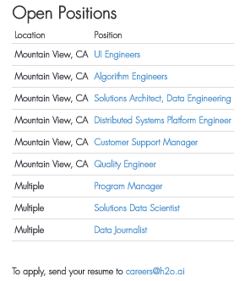
We’re Hiring!
Check it out
www.h2o.ai/careers/

Slide 15
Thanks!
Prezi
Organizers
Budapest DS Meetup
satRdays
Szilard
H2O.ai
Contact
joe@h2o.ai
@matlabulous
github.com/woobe
Resources
docs.h2o.ai
Slides and Code
github.com/h2oai/h2o-meetups

